Slide 1
Nested Subqueries
SQL provides a mechanism for the nesting of subqueries. A subquery is a select-from-where expression that is nested within another query.
The nesting can be done in the following SQL query
select A₁, A₂, ..., A_{n}
from r₁, r₂, ..., r_{m}
where P
as follows:
  A_{i} can be replaced be a subquery that generates a single value.
  r_{i} can be replaced by any valid subquery
  P can be replaced with an expression of the form:
  B <operation> (subquery)
  Where B is an attribute and <operation> to be defined later.

Slide 2
Subqueries in the Where Clause

Slide 3
Subqueries in the Where Clause
A common use of subqueries is to perform tests:
  For set membership
  For set comparisons
  For set cardinality.

Slide 4
Set Membership
Find courses offered in Fall 2009 and in Spring 2010
select distinct course_id
from section
where semester = ’Fall’ and year= 2009 and
course_id in (select course_id
from section
where semester = ’Spring’ and year= 2010);
Find courses offered in Fall 2009 but not in Spring 2010
select distinct course_id
from section
where semester = ’Fall’ and year= 2009 and
course_id not in (select course_id
from section
where semester = ’Spring’ and year= 2010);

Slide 5
Set Membership (Cont.)
Find the total number of (distinct) students who have taken course sections taught by the instructor with ID 10101
select count (distinct ID)
from takes
where (course_id, sec_id, semester, year) in
(select course_id, sec_id, semester, year
from teaches
where teaches.ID= 10101);
Note: Above query can be written in a much simpler manner.
The formulation above is simply to illustrate SQL features.

Slide 6
Set Comparison – “some” Clause
Find names of instructors with salary greater than that of some (at least one) instructor in the Biology department.
select distinct T.name
from instructor as T, instructor as S
where T.salary > S.salary and S.dept name = ’Biology’;
Same query using > some clause
select name
from instructor
where salary > some (select salary
from instructor
where dept name = ’Biology’);

Slide 7
Definition of “some” Clause
F <comp> some r ⇔ ∃ t ∈ r such that (F <comp> t )
Where <comp> can be: <, ≤, >, =, ≠
0
(5 < some
5
) = true
(read: 5 < some tuple in the relation)
6
0
(5 < some
5
) = false
0
(5 = some
) = true
5
0
(5 ≠ some
5
) = true (since 0 ≠ 5)
(= some) ≡ in
However, (≠ some) ≡ not in

Slide 8
Set Comparison – “all” Clause
Find the names of all instructors whose salary is greater than the salary of all instructors in the Biology department.
select name
from instructor
where salary > all (select salary
from instructor
where dept name = ’Biology’);

Slide 9
Definition of “all” Clause
F <comp> all r ⇔ ∀ t ∈ r (F <comp> t)
0
(5 < all
5
) = false
6
6
(5 < all
) = true
10
4
(5 = all
) = false
5
4
(5 ≠ all
) = true (since 5 ≠ 4 and 5 ≠ 6)
6
(≠ all) ≡ not in
However, (= all) ≡ in

Slide 10
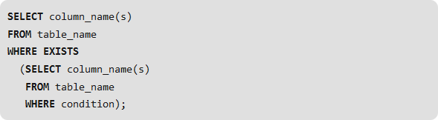
Test for Empty Relations
The exists construct returns the value true if the argument subquery is nonempty.
exists r ⇔ r ≠ Ø
not exists r ⇔ r = Ø

Slide 11
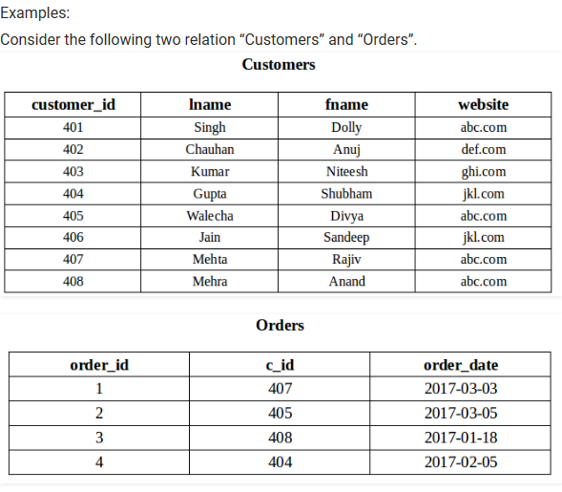
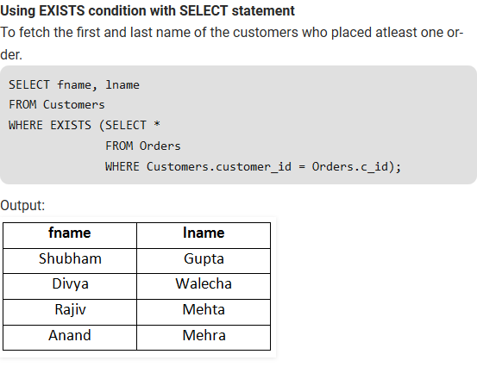
Use of “exists” Clause

Slide 12
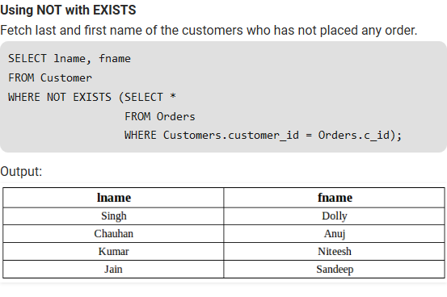
Use of “not exists” Clause

Slide 13
Test for Absence of Duplicate Tuples
The unique construct tests whether a subquery has any duplicate tuples in its result.
The unique construct evaluates to “true” if a given subquery contains no duplicates .
Find all courses that were offered at most once in 2009
  select T.course_id
  from course as T
  where unique (select R.course_id
  from section as R
  where T.course_id= R.course_id
  and R.year = 2009);

Slide 14
Subqueries in the Form Clause

Slide 15
Subqueries in the Form Clause
SQL allows a subquery expression to be used in the from clause
Find the average instructors’ salaries of those departments where the average salary is greater than $42,000.”
  select dept_name, avg_salary
  from (select dept_name, avg (salary) as avg_salary
  from instructor
  group by dept_name)
  where avg_salary > 42000;
Note that we do not need to use the having clause
Another way to write above query
  select dept_name, avg_salary
  from (select dept_name, avg (salary)
  from instructor
  group by dept_name) as dept_avg (dept_name, avg_salary)
  where avg_salary > 42000;

Slide 16
With Clause
The with clause provides a way of defining a temporary relation whose definition is available only to the query in which the with clause occurs.
Find all departments with the maximum budget
with max_budget (value) as
(select max(budget)
from department)
select department.name
from department, max_budget
where department.budget = max_budget.value;

Slide 17
Complex Queries using With Clause
Find all departments where the total salary is greater than the average of the total salary at all departments
with dept _total (dept_name, value) as
(select dept_name, sum(salary)
from instructor
group by dept_name),
dept_total_avg(value) as
(select avg(value)
from dept_total)
select dept_name
from dept_total, dept_total_avg
where dept_total.value > dept_total_avg.value;

Slide 18
Subqueries in the Select Clause

Slide 19
Scalar Subquery
Scalar subquery is one which is used where a single value is expected
List all departments along with the number of instructors in each department
select dept_name,
(select count(*)
from instructor
where department.dept_name = instructor.dept_name)
as num_instructors
from department;
Runtime error if subquery returns more than one result tuple

Slide 20
Modification of the Database
Deletion of tuples from a given relation.
Insertion of new tuples into a given relation
Updating of values in some tuples in a given relation

Slide 21
Deletion
Delete all instructors
delete from instructor
Delete all instructors from the Finance department
delete from instructor
where dept_name= ’Finance’;
Delete all tuples in the instructor relation for those instructors associated with a department located in the Watson building.
delete from instructor
where dept name in (select dept name
from department
where building = ’Watson’);

Slide 22
Deletion (Cont.)
Delete all instructors whose salary is less than the average salary of instructors
delete from instructor
where salary < (select avg (salary)
from instructor);
  Problem: as we delete tuples from deposit, the average salary changes
  Solution used in SQL:
  1. First, compute avg (salary) and find all tuples to delete
  2. Next, delete all tuples found above (without
  recomputing avg or retesting the tuples)

Slide 23
Insertion
Add a new tuple to course
insert into course
values (’CS-437’, ’Database Systems’, ’Comp. Sci.’, 4);
or equivalently
insert into course (course_id, title, dept_name, credits)
values (’CS-437’, ’Database Systems’, ’Comp. Sci.’, 4);
Add a new tuple to student with tot_creds set to null
insert into student
values (’3003’, ’Green’, ’Finance’, null);

Slide 24
Insertion (Cont.)
Add all instructors to the student relation with tot_creds set to 0
insert into student
select ID, name, dept_name, 0
from instructor
The select from where statement is evaluated fully before any of its results are inserted into the relation.
Otherwise queries like
insert into table1 select * from table1
would cause problem

Slide 25
Updates
Increase salaries of instructors whose salary is over $100,000 by 3%, and all others by a 5%
  Write two update statements:
  update instructor
  set salary = salary * 1.03
  where salary > 100000;
  update instructor
  set salary = salary * 1.05
  where salary <= 100000;
  The order is important
  Can be done better using the case statement (next slide)

Slide 26
Case Statement for Conditional Updates
Same query as before but with case statement
update instructor
set salary = case
when salary <= 100000 then salary * 1.05
else salary * 1.03
end

Slide 27
Updates with Scalar Subqueries
Recompute and update tot_creds value for all students
update student S
set tot_cred = (select sum(credits)
from takes, course
where takes.course_id = course.course_id and
S.ID= takes.ID.and takes.grade <> ’F’ and
takes.grade is not null);
Sets tot_creds to null for students who have not taken any course
Instead of sum(credits), use:
case
when sum(credits) is not null then sum(credits)
else 0
end

Slide 28
End of Chapter 3

